Slide 1
Participant Experience: CESAR Project
Mladen Stanojević, PhD
Institute Mihajlo Pupin, Serbia
Mladen.Stanojevic@pupin.rs
Information Day for Call 7 of ICT PSP
Belgrade, 28.02.2013

Slide 2
Outline
CESAR consortium
Project objectives
Activities of Serbian partners
How we got involved
Preparation of project proposal
Project administration
Advices to newcomers

Slide 3
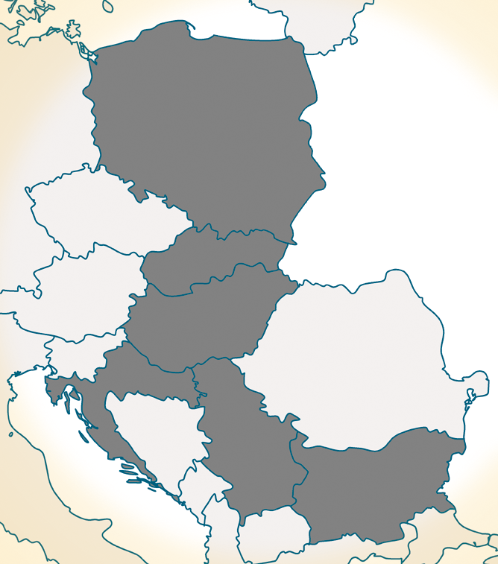
Geo-linguistic position
CESAR stands for CEntral and Southeast EuropeAn Resources
Operates as integral part of META-NET
Geo-linguistic spread
Central and Southeast Europe
three inner seas: Baltic, Adriatic, Black Sea
CESAR covers languages
Polish EU, 38M (40-48M)
Slovak EU, 5.4M (7M)
Hungarian EU, 10M (16M)
Croatian EU in 2013, 4.4M (5.5M)
Serbian candidate, 7.3M (9M)
Bulgarian EU, 7.5M (9M)
All languages Slavic, except Hungarian
Notes:
Folie entfernen?

Slide 4
Who is CESAR?
Participant no. | Participant organisation name | Participant short name | Country
1 (CO) | Nyelvtudományi Intézet, Magyar Tudományos Akadémia | HASRIL | Hungary
2 | Budapesti Műszaki és Gazdaságtudományi Egyetem | BME-TMIT | Hungary
3 | Sveučilište u Zagrebu, Filozofski Fakultet – University of Zagreb, Faculty of Humanities and Social Sciences | FFZG | Croatia
4 | Instytut Podstaw Informatyki Polskej Akademii Nauk | IPIPAN | Poland
5 | Uniwersytet Lodzki | Ulodz | Poland
6 | Faculty of Mathematics, University of Belgrade | UBG | Serbia
7 | Institut Mihajlo Pupin | IPUP | Serbia
8 | The Institute for Bulgarian Language Prof. Lyubomir Andreychin | IBL | Bulgaria
9 | Jazykovedny Ústav Ludovíta Stúra Slovenskej Akadémie Vied | LSIL | Slovakia

Slide 5
Project objectives
Provide a description of the national landscape in terms of
Language use, language-savvy products and services, language technologies and resources
Contribute to a pan-European digital language resources exchange (META-SHARE)
Enhance, extend, document, standardize, cross-link, cross-align resources and tools
Mobilise national and regional stakeholders, public bodies and funding
Reinvigorate cooperation between key technology partners in the region
Collaborate with other partner projects
Bridge the technological gap between this region and the other parts of Europe

Slide 6
Where to find CESAR
www.meta-net.eu

Slide 7
www.cesar-project.net

Slide 8
Activities of Serbian partners
University of Belgrade, Faculty of Mathematics
Several language resources in Serbian (Serbian WordNet, monolingual and multilingual corpora, dictionaries, etc.)
Institute Mihajlo Pupin
Make NooJ open source
Make NooJ platform independent
Make NooJ maximally interoperable by making sure it will seamlessly work with major tools
Common activities
The Serbian Language in the Digital Age, LWP Series, Springer, 2012
CESAR Roadshow dissemination event, Belgrade, October 2012

Slide 9
How we got involved
EC diagnosed an acute lack of language resources for many European Langauges
META-NET FP7 Network of Excellence
ICT PSP Call for proposals to enhance language resources for different European languages (CESAR, META-NORD, METANET4U)
Institute Mihajlo Pupin is not involved in developing language technologies or providing language resources
Prof. Sanja Vraneš is an evaluator for FP7 ICT project proposals (Digital Content, Language Technologies)

Slide 10
Preparation of project proposal
Provide a PIC and appoint LEAR
Find and join the consortium
Fill-in Part A online forms
Create Part B (what will be done in the project)

Slide 11
Project administration
Technical administration
Activities according to DoW (deliverables on time)
Review meetings (reviewers check the work done comparing to DoW)
Financial administration
Timesheets
Salaries
Receipts for all costs (travel, equipment, subcontracting, etc.)
Financial reports

Slide 12
Advices for newcomers
Competition is much lower than for FP7 project proposals
Improve your networking (evaluators, reviewers for FP7 projects)
Do not act as a Project Coordinator, but join an existing consortium
Appoint F/A officer for efficient administration of the project
All activities are funded 50% by the EC, so you have to provide another 50% on your own

Slide 13
Q/A
Thank you very much for your attention!
http://www.cesar-project.net
office@meta-net.eu
http://www.meta-net.eu
http://www.facebook.com/META.Alliance

